Slide 1


Mechanism Dynamics and Haptic Performance
Colin Gallacher
Supervisor:
Jozsef Kovecses

Slide 2
Course Introduction
Objectives:
Demystify mechatronics
2) Understand the basics behind how a microcontroller works
3) Familiarize you with concepts like digital signals
4) Get your hands dirty by building circuits and writing code
5) Set yourself up to start your own projects

Slide 3
Syllabus

Slide 4
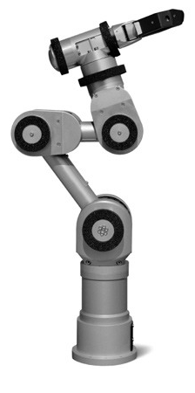
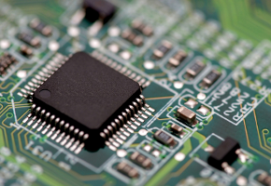
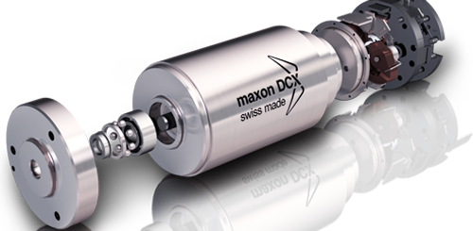
What is a Microcontroller

Slide 5
Touching Our World
Open packages

Slide 6
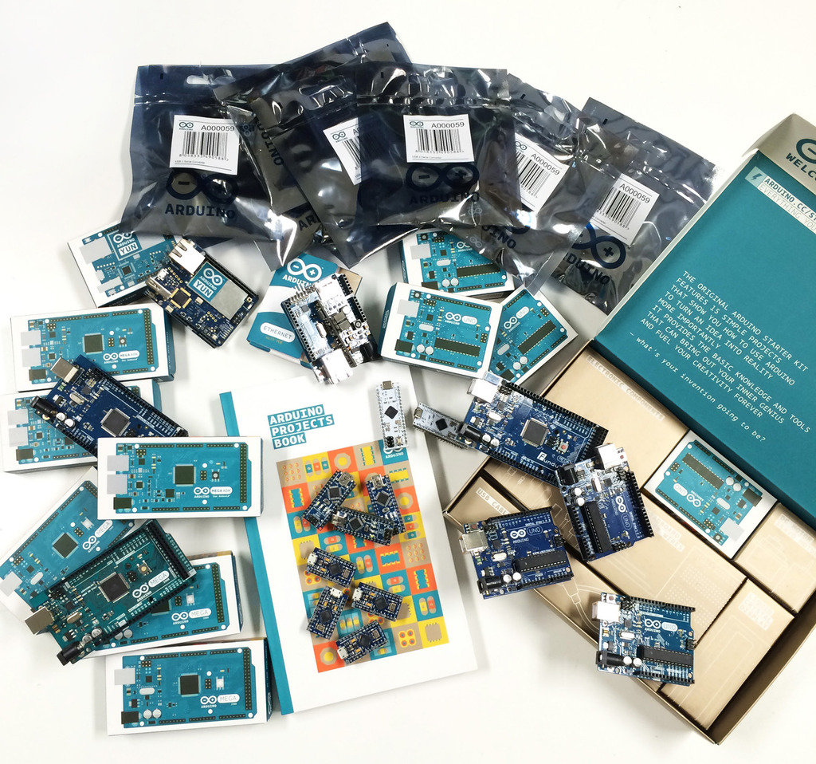
The Arduino

Slide 7
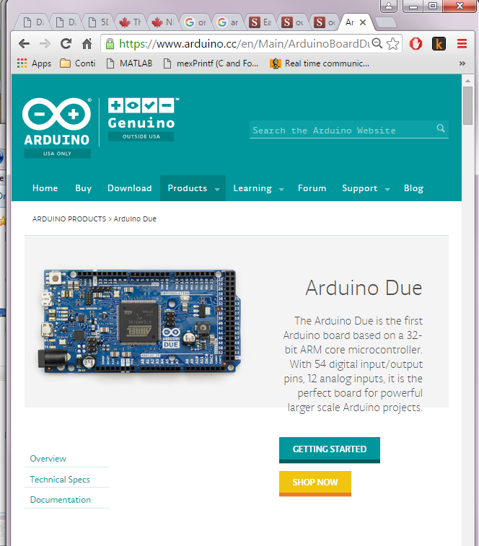

Slide 8
The Haply Board

Slide 10
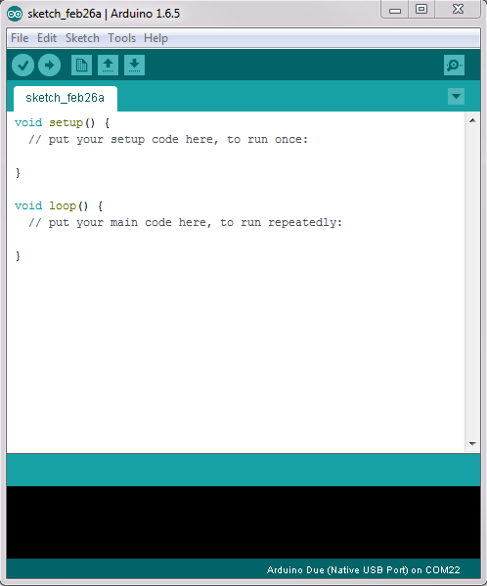
Arduino IDE
Download Arduino 1.6.5
Download Arduino DUE support
Check to make sure the drivers are installed
Check to see if boards can be flashed (teach steps)
Notes:
Create a Package for all the students to use
Walk through the creation of all the boards

Slide 11
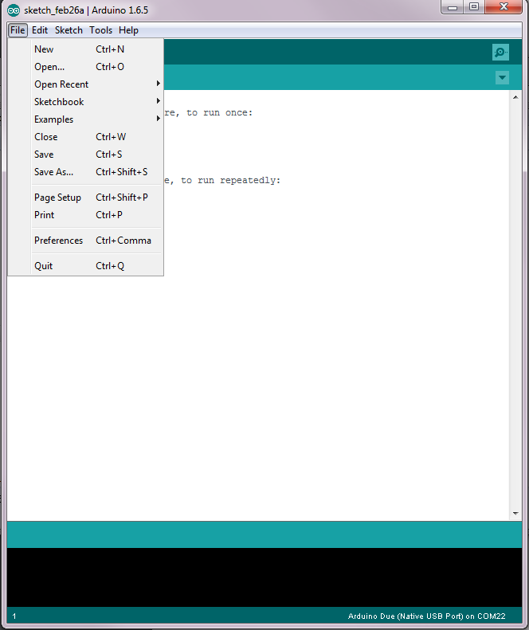
Arduino IDE
Download Arduino 1.6.5
Download Arduino DUE support
Download
Notes:
Create a Package for all the students to use
Walk through the creation of all the boards

Slide 12
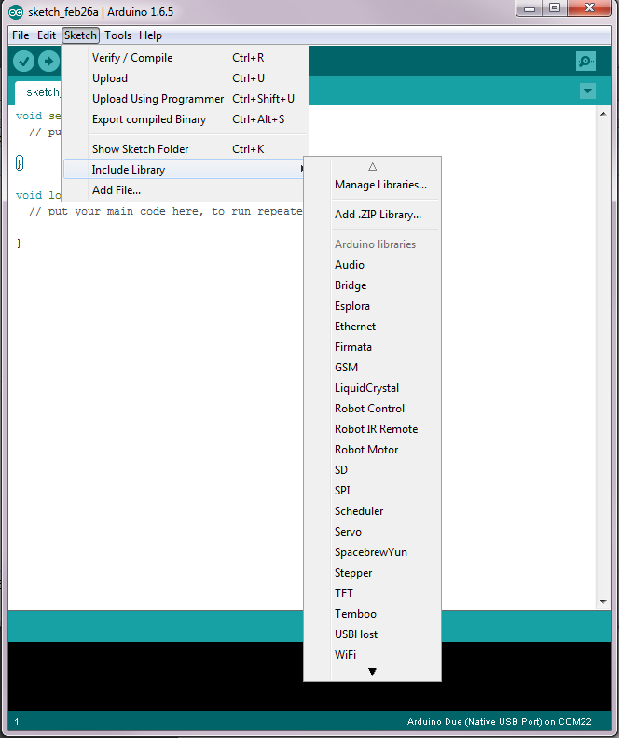

Slide 13
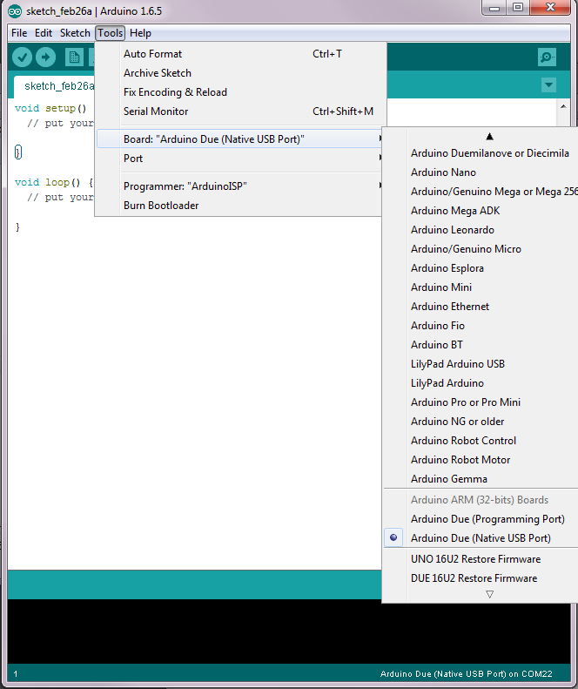

Slide 14
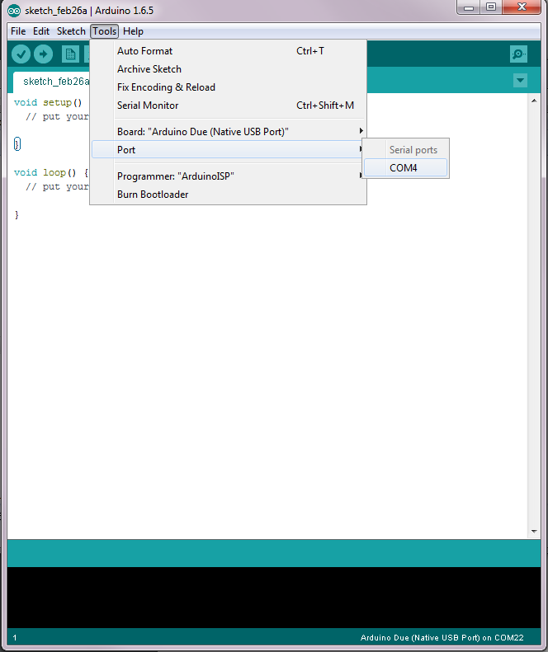

Slide 15
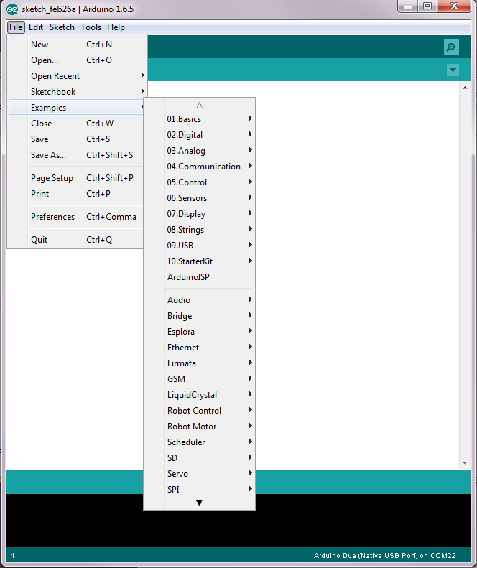

Slide 16
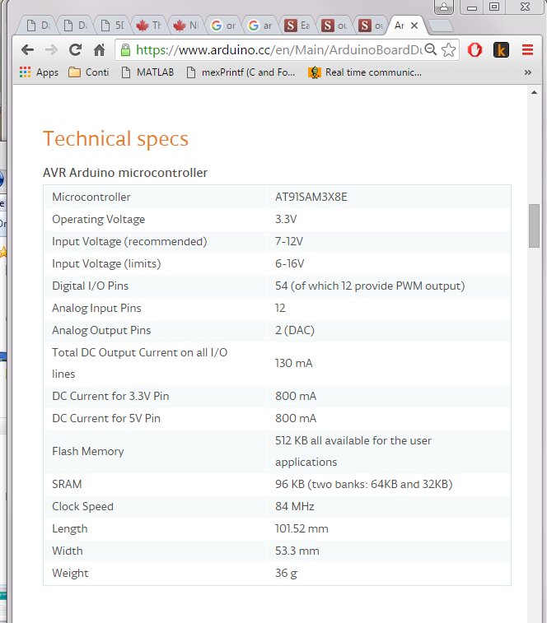

Slide 17
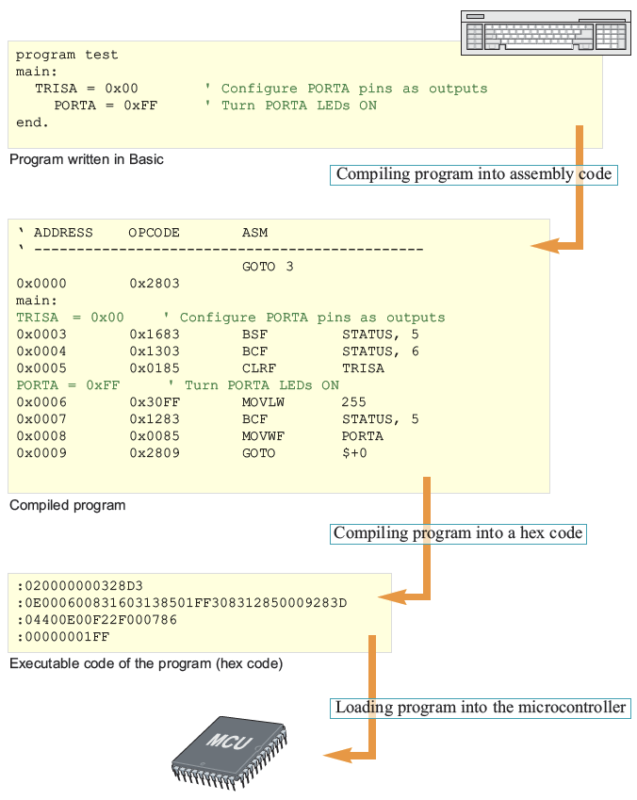
I Can ‘C’ Clearly Now
What happens when we program a microcontroller?

Slide 18
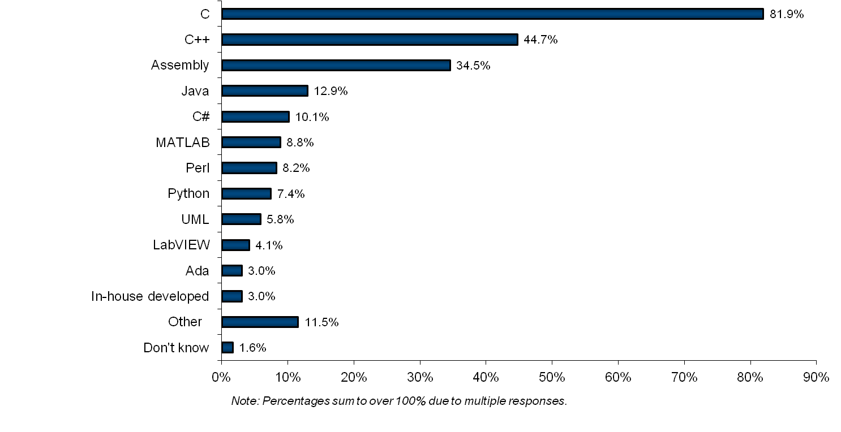
Embedded System Languages
VDC survey of embedded developers

Slide 19
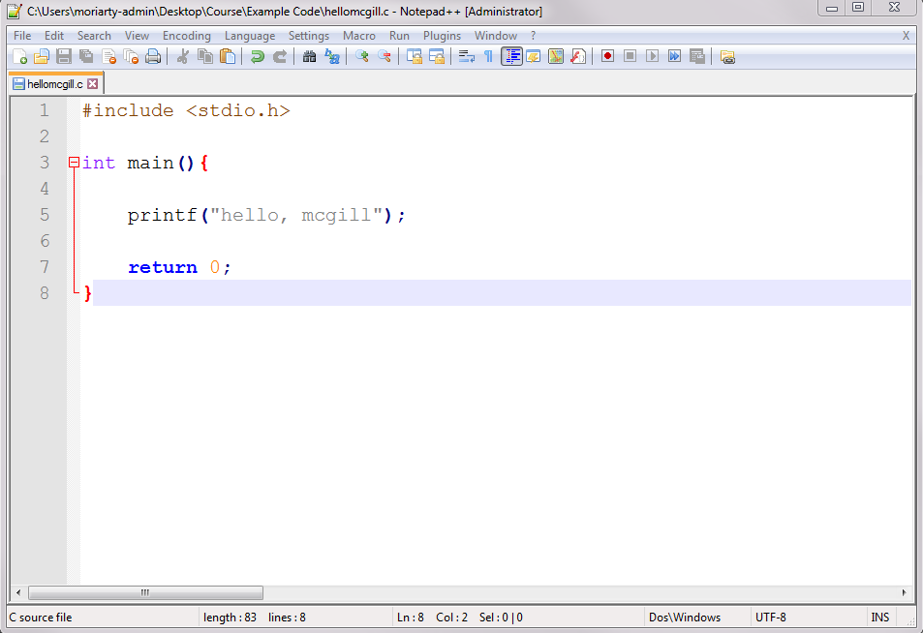
I Can ‘C’ Clearly Now
C(and C++) is a system level language (i.e. can run on your microprocessor with no additional support)
C is available for almost all microcontroller architectures

Slide 20
Arduino’s Flavor of C

Slide 21
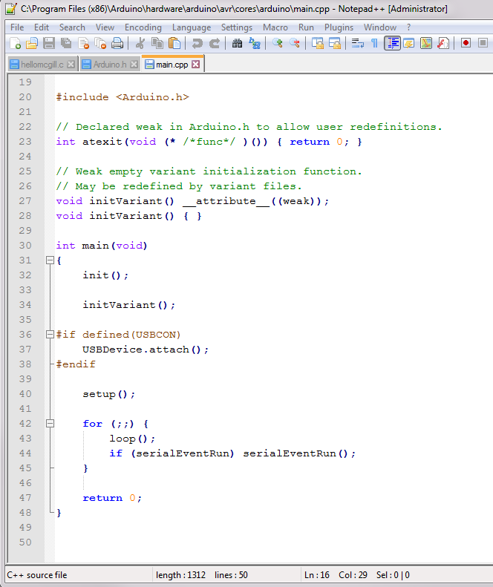
Arduino’s Flavor of C

Slide 22

Libraries and APIs
What is a Programming Library?
A library in C is a group of functions and declarations, exposed for use by other programs
API?
Application Programming Interface

Slide 23
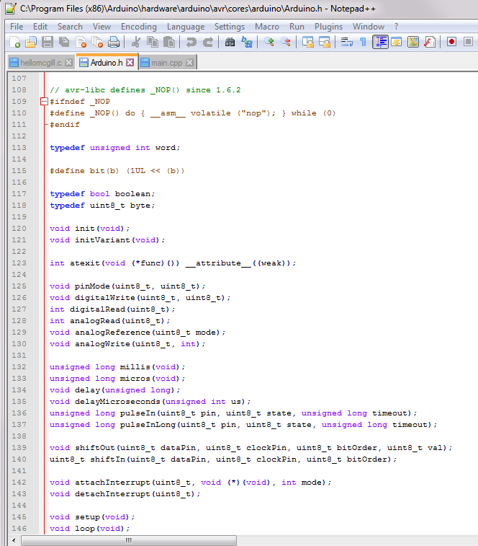
Libraries and APIs
The Arduino Standard Library
Header file:
Arduino.h
Creates ‘wrappers’ that are easy to use commands that control the board

Slide 24
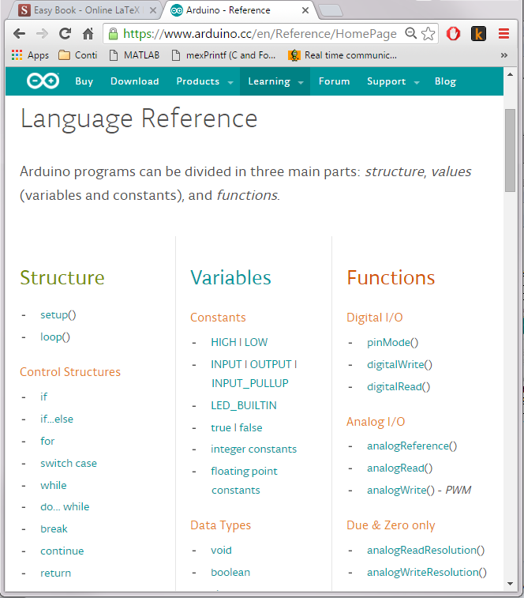
Standard Arduino Library
Includes a bunch of basic functionality to control the Arduino board.

Slide 25
Data
Bit
Nibble
Byte
Word (chomp)
Are these specific to the machine? No this is what the 8 bit vs 16 bit vs 32 bit vs 64 bit means

Slide 26
Data Structures: Archatechture
byte
char
int
word
uint8_t
uint16_t

Slide 27
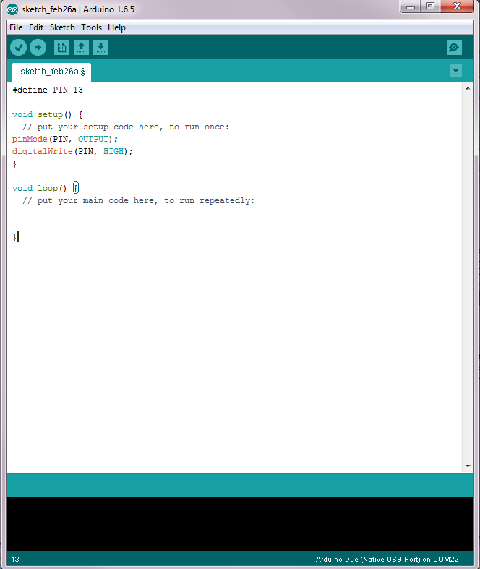
Example: Our First Program
Step 1: Turn on the light
1.0

Slide 28
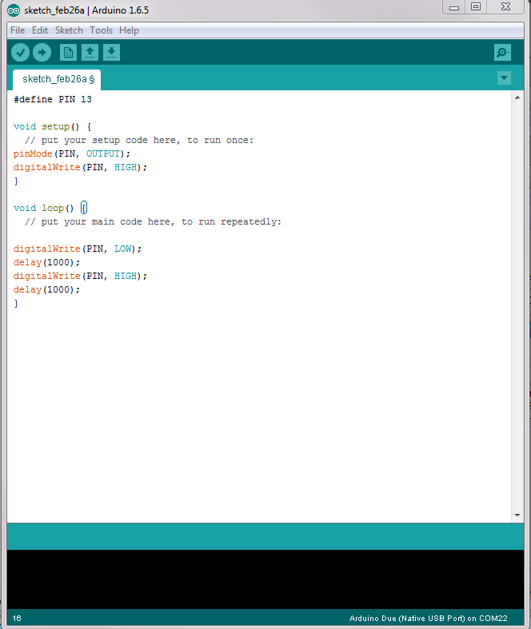
Example: Our First Program
Step 2: Make it Blink!
1.1
Question: Why might we not want to use a delay?

Slide 29
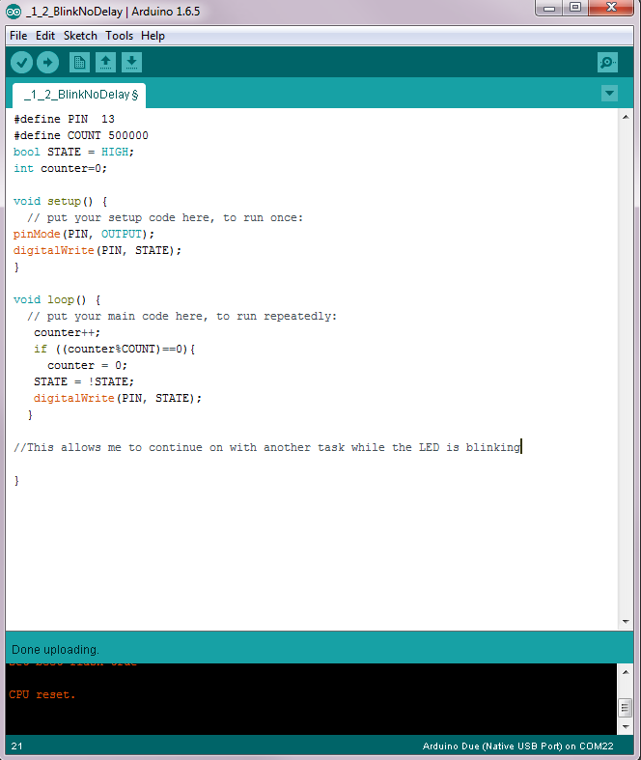
1.2

Slide 30

Debugging with Arduino
Use Serial Port
What is Serial Communication?
Communication through the tin cans

Slide 31
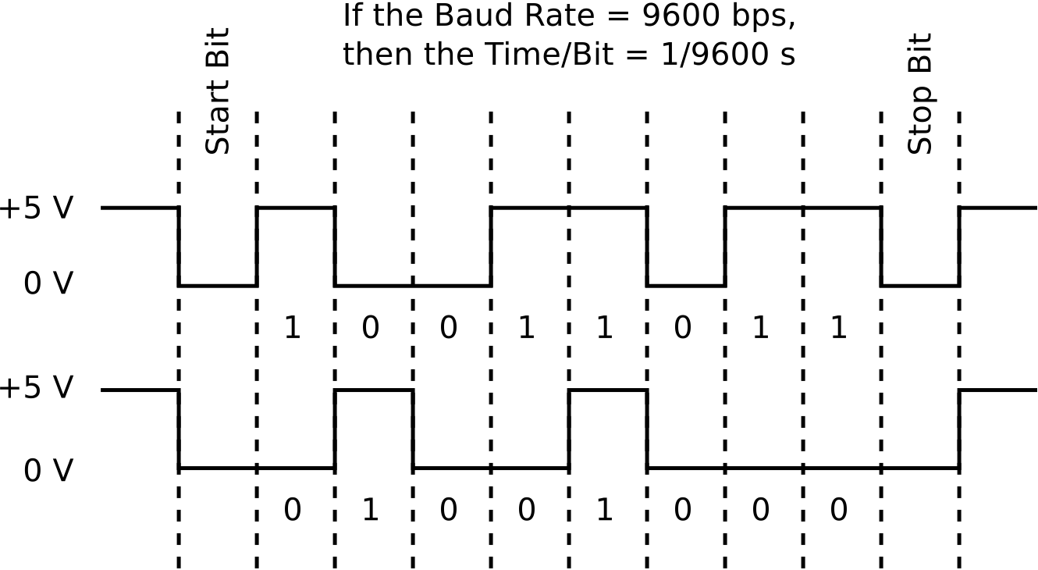
Debugging with Arduino
Use Serial Port
What is Serial Communication?
Communication through the tin cans

Slide 32
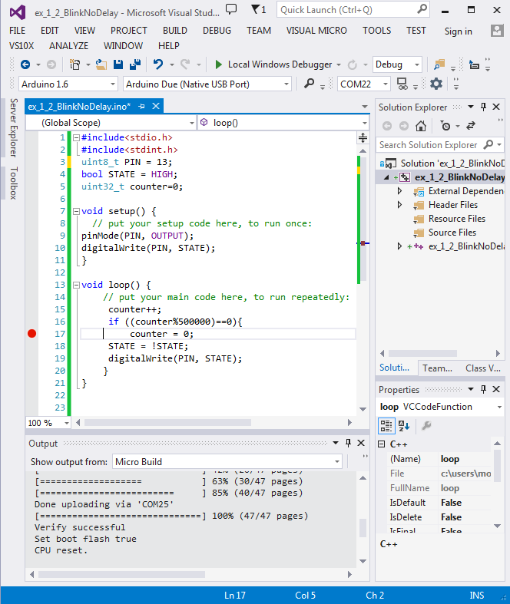
Additional Options
Visual Micro

Slide 33
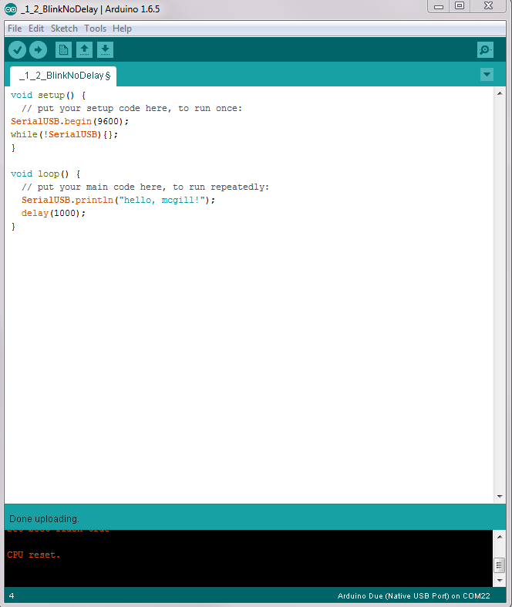
Example: Our First Program
Steps: 1
2.0

Slide 34
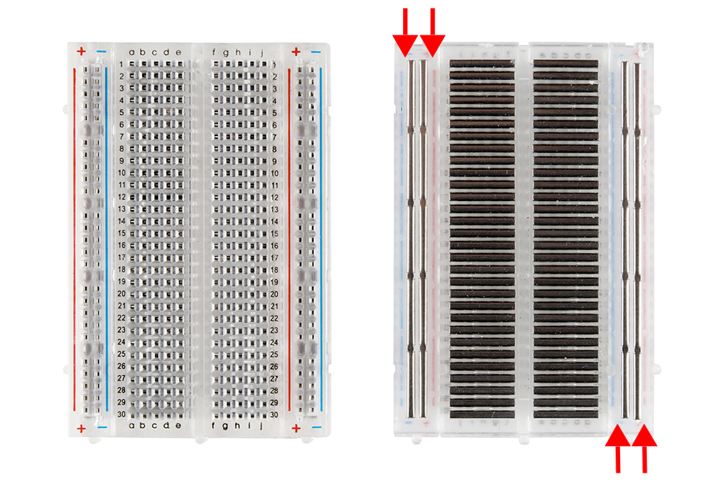

Slide 35
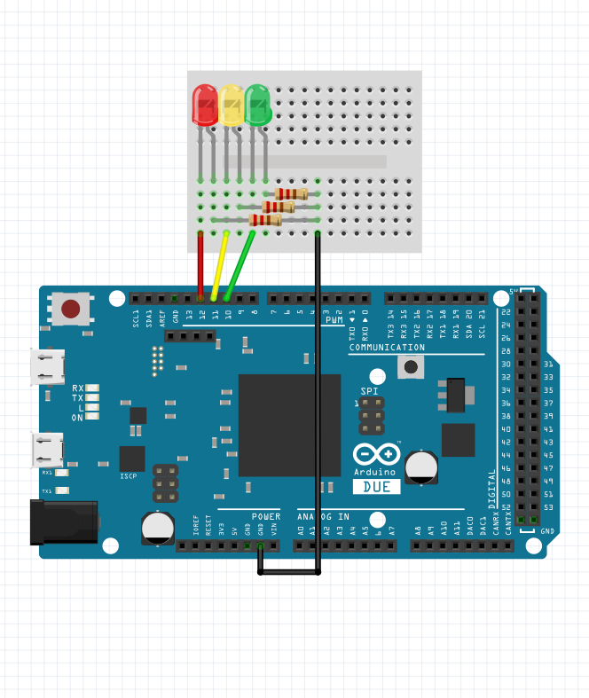
Example: Debug Multiple LEDs
2.1

Slide 36
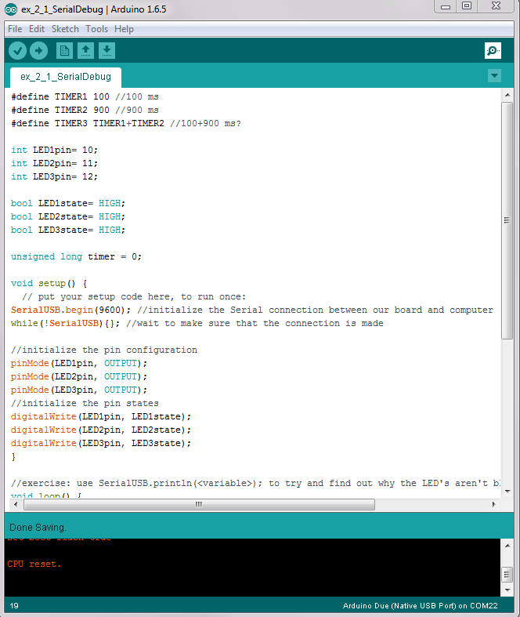
Example: Debug Multiple LEDs
2.1

Slide 37
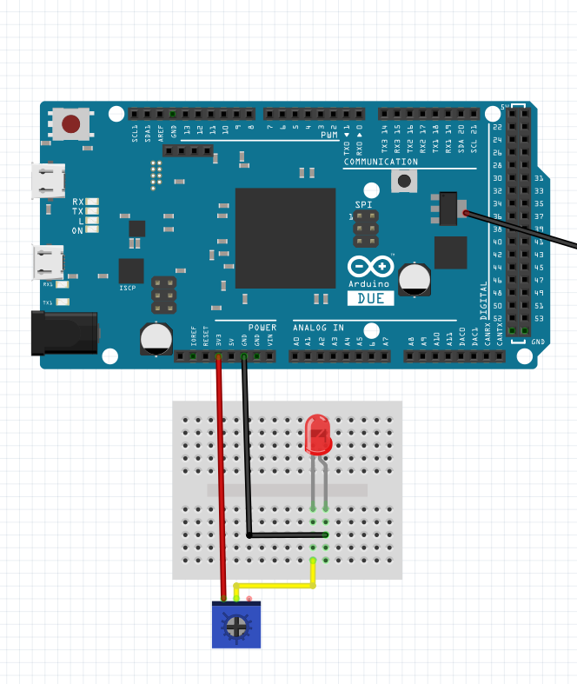
Example 3.0: Analog LED
3.0 Analog Control of LED

Slide 38
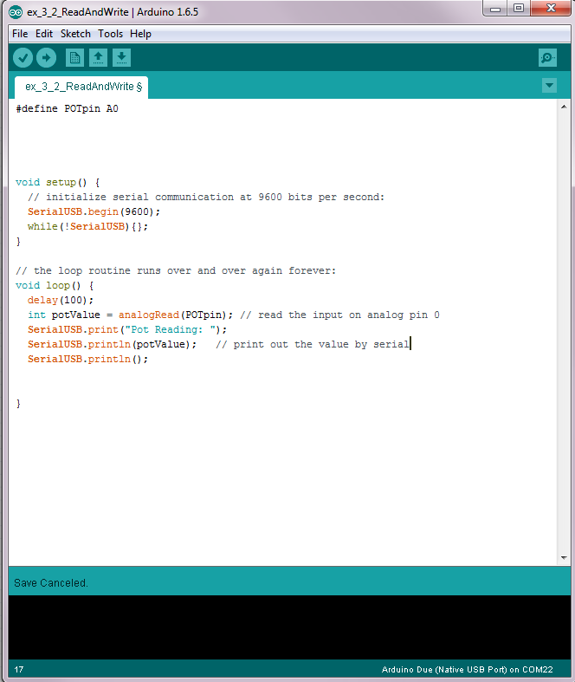
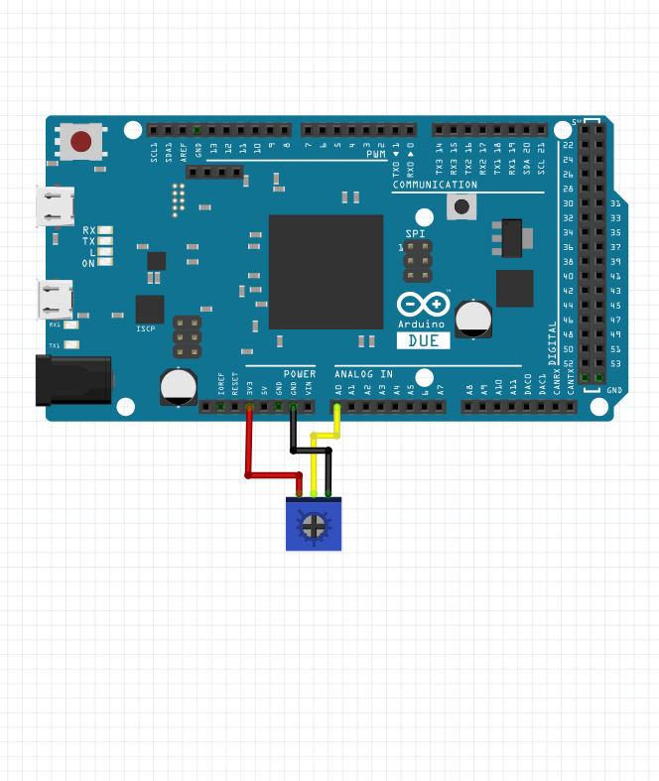
Example 3.1: Reading Analog

Slide 39
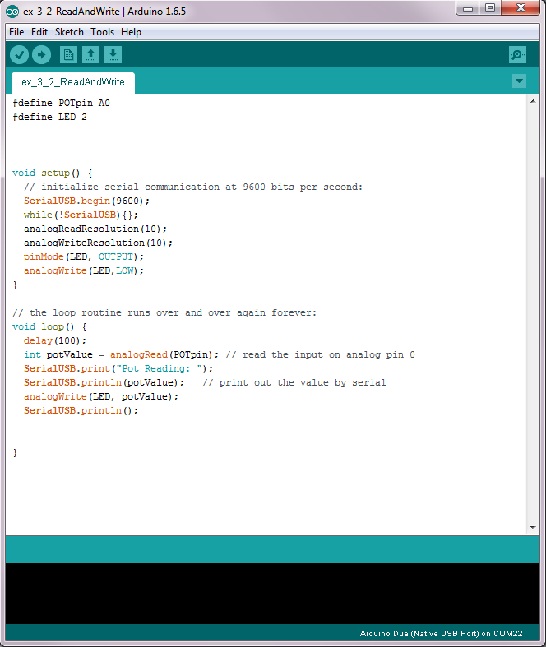
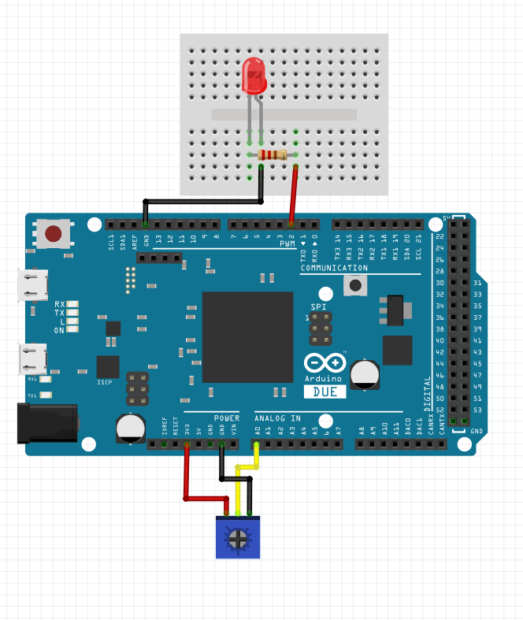
Example 3.2: Writing Analog(ish)
Notes:
Here we have a couple things of interest:
What is the value of the signal being written to the PWM
Can we read the PWM signal using an analog read?

Slide 40
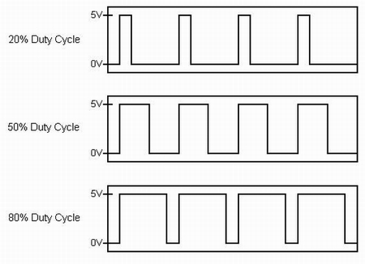
PWM Signal
Lesson

Slide 41
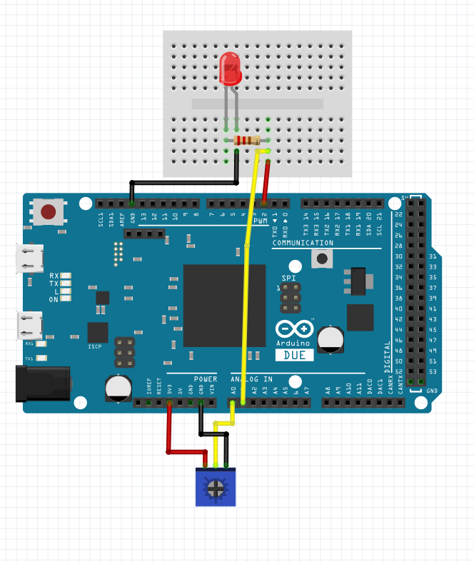
Question:
What do you think will happen if we read the PWM signal using the Analog Read Pin?

Slide 42
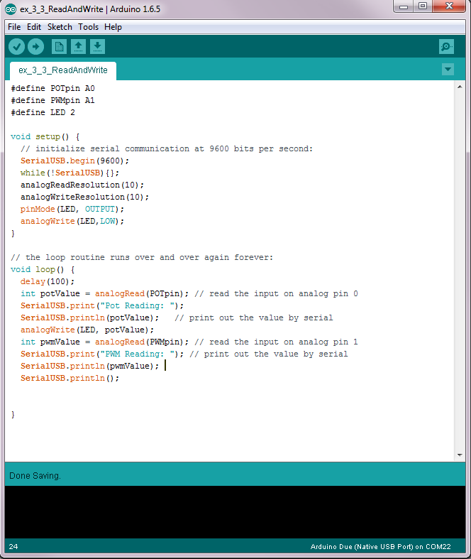
Example 3.3: Reading And Writing

Slide 43
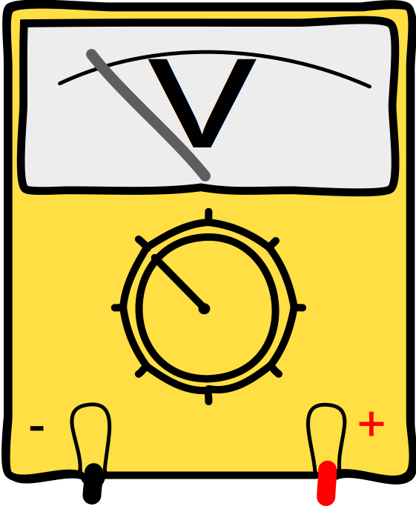
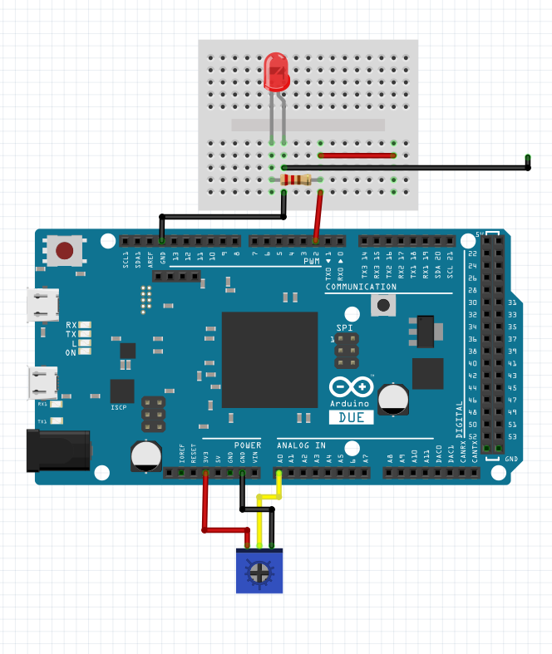
Example 3.4: Reading And Writing
3.4

Slide 44
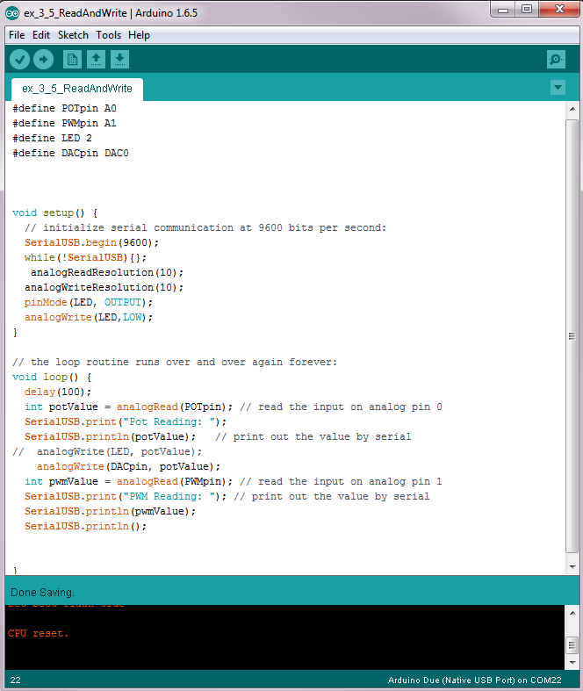
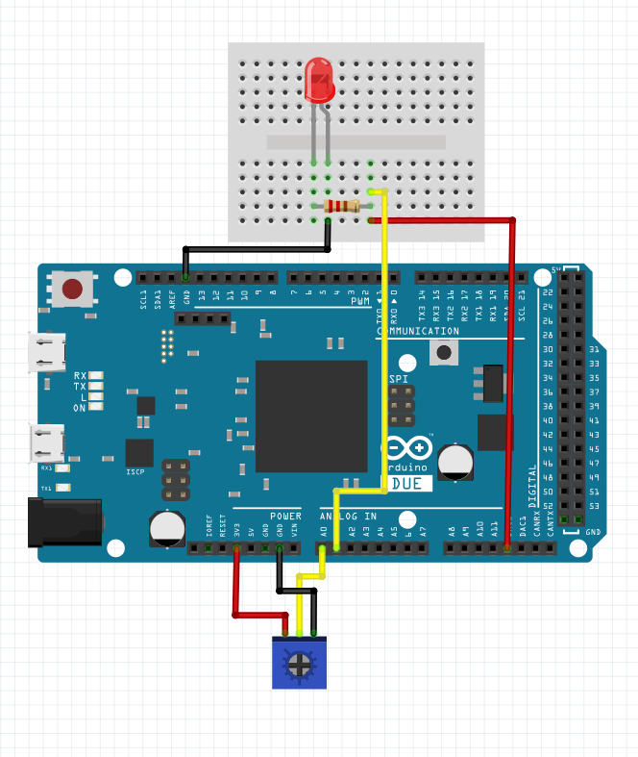
Example 3.5: Reading And Writing
Notes:
Why is the DAC not exactly the same as the written signal?

Slide 45
Recap
Now you have a basic background about how to use a micro controller
Read and Write digital signals
Debug using the Serial
Locate libraries
Read up on their functionality

Slide 46

Motivation: Domo Arigoto
Notes:
Software is cool but interacting with the physical world is cooler
Microcontrollers are just that they sense data to control something about the physical world around them
A little experience reading and writing signals
Now let’s move on to something more robotic

Slide 47
Motivation: Domo Arigoto
Notes:
Move on to More intermediate lesson:
Sensing and actuation

Slide 48
Sensing
Deal in digital signals

Slide 49
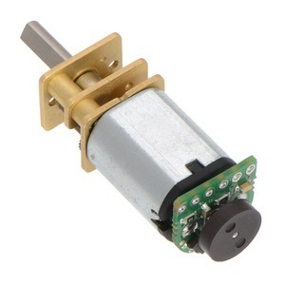
Encoders
Notes:
Encoder library?
#include <Encoder.h>

Slide 50
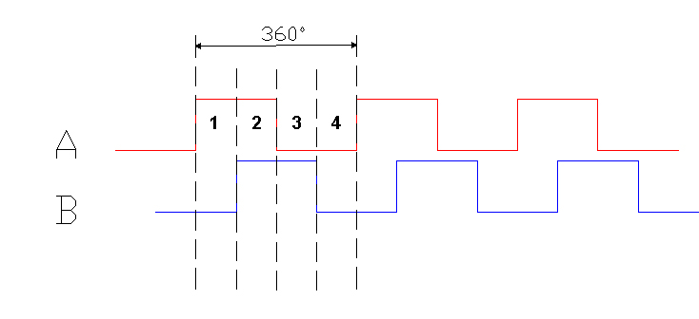
Quadrature
Yay digital signals!
Notes:
Need a reference voltage
A Ground (make sence of reference voltage)
A out
And B Out

Slide 51
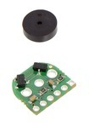
Quadrature
Yay digital signals!
Steps to include Library
Library as tool
Notes:
Need a reference voltage
A Ground (make sence of reference voltage)
A out
And B Out

Slide 52
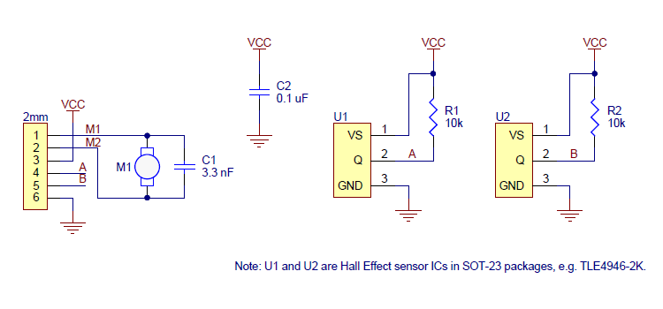
Data Sheet and Circuit Diagram

Slide 53
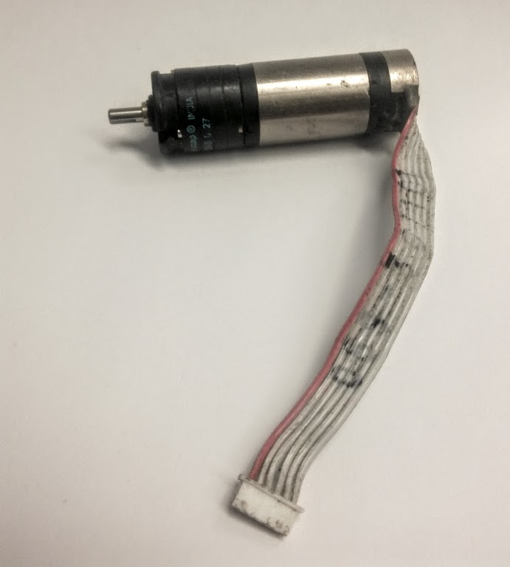
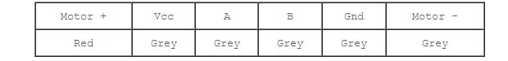
Data Sheet and Circuit Diagram
128 PPR
Gearing 27.1:1
This means we amplify torque in one direction and increase the encoder resolution in the other.
What is the downside?

Slide 54
Data Sheet and Circuit Diagram
Challenge using:
Haplet Board Schematic
1) Find the J3- connector port on the Haplet Board Motors page
2) Write down what pins 1-6 correspond to.
3) Find those pins on The Haplet Board MCU
4) Use those pins for the encoder inputs

Slide 55
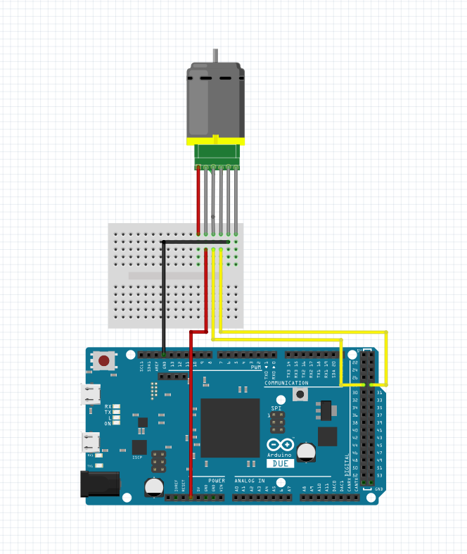
Data Sheet and Circuit Diagram
The analogous Arduino Due Configuration!

Slide 56
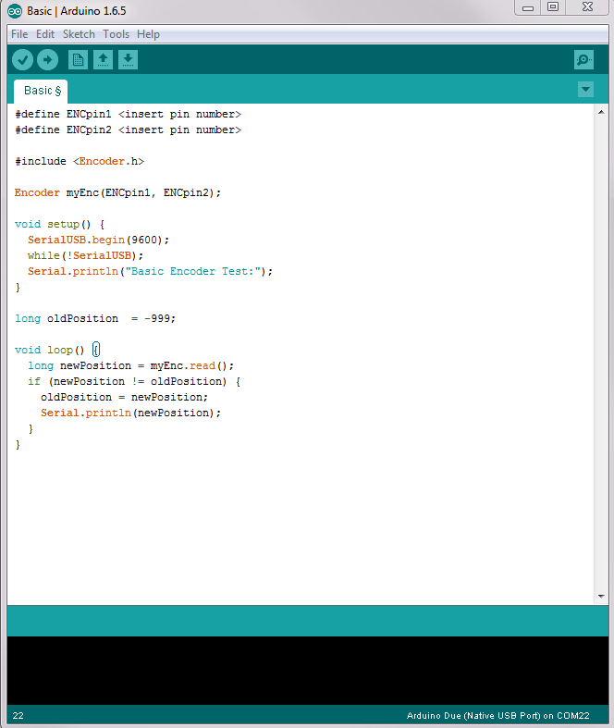
Example 4.0: Reading Positions
PPR
Calculation
Picture of Motor plugged into J3

Slide 57
Oscilliscope to show signal?
They can use their Analog pins to read the signals? Or will fry?

Slide 58
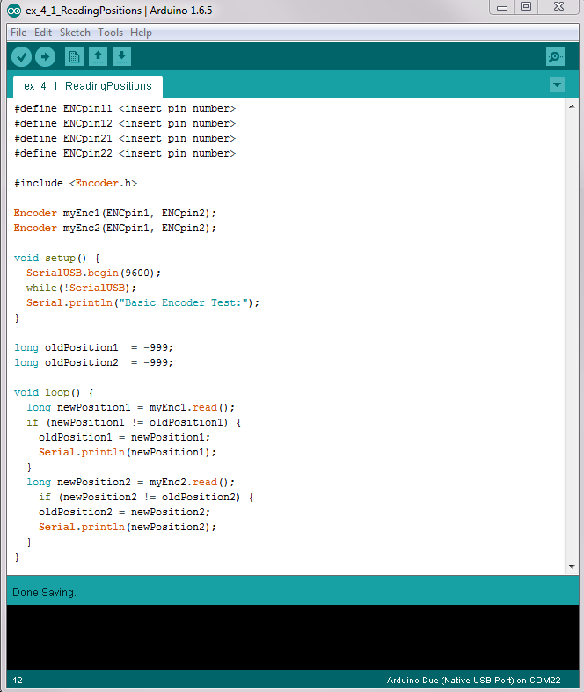
Example 4.1: Reading Positions
4.0
Plug motor into J4 (on opposite side)

Slide 59
Actuation
We’ve sensed the world around us now let’s output some energy and interact!

Slide 60
DC Motor

Slide 61
Motor Driver

Slide 62
H-Bridge

Slide 63
Example: Motor Velocity
5.0

Slide 64
Control

Slide 65
PD Controller
6.0

Slide 66
Hapkit sketch
7.0

Slide 67
3D Printing and Homework

